Slide 1

Basic Necessities of NEHS Chapter Management
Presented by
Elancia Felder, Senior Program Manager
October 20, 2022
NHS, NJHS, NEHS, and National Student Council are programs of NASSP.

Slide 2

Before we begin…
This webinar is being recorded and will be posted on the NEHS website for on-demand viewing.
Please use the Q&A feature to post questions. There will be a Q&A section at the end.

Slide 3
HISTORICAL OVERVIEW
Established in 2008, the National Elementary Honor Society (NEHS) is a program of and administered by the National Association of Secondary School Principals.
The purpose of this organization shall be to recognize students for their outstanding academic achievement and demonstrated personal responsibility, to provide service to the school and community, and to develop leadership skills in the students of elementary schools.

Slide 4
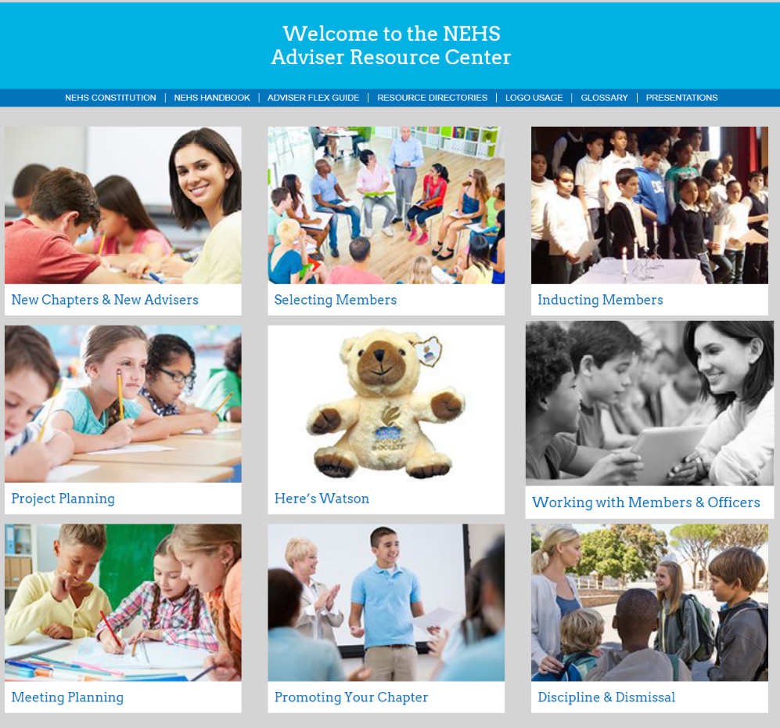
Adviser Resources

Slide 5
The Basic Necessities of NEHS Chapter Management
Affiliate with the National Office
Form a faculty council
Create chapter bylaws
Create selection procedures
Publish selection procedures
Select and induct new members
Review chapter policies & members regularly
Hold meetings of the chapter
Conduct chapter service projects
Submit the annual report
Let’s examine each…..

Slide 6
Basic Necessities: Affiliation
Invoices are mailed to principals by NASSP each spring, and email reminders are sent to advisers and principals.
Submit the invoice and annual payment by June 30 each year.
The membership year runs from July 1 – June 30.

Slide 7
Basic Necessities: Form a Faculty Council
The selection of new members and disciplining of members is the responsibility of the faculty council.
The council consists of the chapter adviser and at least two other voting faculty members appointed by the principal.
The council composition should be an odd number. Decisions are made by majority vote of the council.
The principal and assistant principal may not serve on the council or vote.
Notes:
NEHS Constitution reference: Article 6
See additional information in the Adviser Resource Center
Bylaws amplify and clarify the operating procedures of each chapter.
Bylaws should include information concerning selection of members, chapter elections, officer duties, schedule of meetings, dues, etc.
Chapter bylaws do not need to be approved by the national office, but must adhere to the provisions of the National Constitution.

Slide 8
Basic Necessities: Chapter Bylaws
Each chapter must create its own set of bylaws.
Bylaws should include information concerning selection of members, chapter elections, officer duties, schedule of meetings, dues, etc.
Notes:
Bylaws amplify and clarify the operating procedures of each chapter. Reference: Article 14 of the NEHS Constitution.
Bylaws should include information concerning selection of members, chapter elections, officer duties, schedule of meetings, dues, etc.
Chapter bylaws do not need to be approved by the national office but must adhere to the provisions of the National Constitution.

Slide 9
Basic Necessities: Create Your Selection Procedures
Drafting selection procedures is the responsibility of the Faculty Council. The principal has final approval.
This process must be fair, non-discriminatory, and consistent with the rules and regulations of NEHS.
Notes:
The task of drafting the chapter’s selection procedures is undertaken by a five-member Faculty Council, facilitated by the chapter adviser and approved by the principal.
Process must be fair, non-discriminatory, and consistent with the rules and regulations of NEHS.
Reference: Article 7, Article 9, section 3

Slide 10
Basic Necessities: Publishing
All chapters are required to publish a description of their selection procedures. This is public information and must be available year-round.
Acceptable publishing locations include the school website, school newsletter, or school handbook.
Publishing a description of the selection process helps to prevent issues raised by students or parents who may wish to question the chapter’s procedures.
At a minimum, the procedure should include: the required cumulative GPA, the time of year your process takes place, the grade levels considered for membership.
Notes:
Lack of publishing is the #1 complaint received by the national office from parents.

Slide 11
Basic Necessities: Select and Induct New Members
All academically eligible candidates must be notified of their eligibility.
The selection of new members is decided by a majority vote of the faculty council.
Principals must review and approve the decisions prior to notifying the candidates and families.
Principals have the authority to hear appeals for non-selection and dismissal.

Slide 12
Basic Necessities: Select and Induct New Members
Candidates become members when inducted at a special ceremony.
The details of the ceremony (location, program, timing) are determined at the local level.
Recommendations are provided in the ARC and Handbooks.
An informal induction can be held later for students unable to attend due to illness, personal emergency, or other legitimate conflict.

Slide 13
Basic Necessities: Regular Reviews
Advisers are responsible for reviewing chapter policies and procedures to ensure compliance with national policies.
Changes to Honor Society policy can be found in the NEHS Constitution and in communications from the national office.
Advisers are also responsible for reviewing student members for compliance with the standards of the chapter and fulfillment of their membership obligations.

Slide 14
Basic Necessities: Meetings
Member responsibilities and obligations concerning meetings should be outlined in the chapter bylaws.
Determine what other benefit the member can provide to the chapter if they have a legitimate conflict.
Notes:
Member responsibilities and obligations concerning meetings should be outlined in the chapter bylaws.
Chapters are cautioned against dismissing members solely based upon poor meeting attendance if the member is otherwise satisfying their membership obligations and has a legitimate reason for missing meetings.
Determine what other benefit the member can provide to the chapter if they have a legitimate conflict.

Slide 15
Basic Necessities: Chapter Projects
Chapters are required to perform one or more group projects each quarter of the school year (minimum of 4 projects per year.)
Chapter project ideas can be found in the Student Project Database on the NEHS website at https://www.nehs.org/student-project-database.
Notes:
Projects should fulfill a need within the school or community; have the support of the administration; and be well planned, organized and executed.
Consider submitting all completed/successful projects to be part of the National Student Project Database (see www.nehs.org)

Slide 16
Basic Necessities: Annual Adviser Survey
The Annual Adviser Survey will be open between mid-April - June 30 each year.
Email notification will alert advisers to complete the survey.
Reminders will be sent to advisers.

Slide 17
Basic Necessities: Summary
Advisers:
Provide direct, day-to-day supervision of the chapter.
Serve as a liaison between faculty, administration, students, and community.
Maintain active files on membership, chapter history, activities and financial transactions.
Maintain familiarity with the NEHS Handbook.

Slide 18

Q & A

Slide 19
Reaching the National Office
Office hours: 8:30 a.m. – 5:00 p.m. ET, Monday – Friday
By phone: 800-253-7746
Email: nehs@nehs.org or policy@nhs.us
Website: www.nehs.org
Always indicate “adviser” or “principal” when calling.

Slide 20
Thank You
NHS, NJHS, NEHS, and NASC are programs of NASSP

